Slide 1
Lecture 02 – Fundamentals of digital imaging I
SIN 392 – Introduction to Digital Image Processing (2023)
Prof. João Fernando Mari
joaofmari.github.io
joaof.mari@ufv.br

Slide 2
Agenda
The human eye
Photographic camera
The digital image
Colored images– RGB
The RGB color space
Image acquisition
CCD sensor and Bayer pattern
Sampling
Effects of spatial resolution
Intensity resolution
Effects of intensity resolution

Slide 3
The human eye
Iris
Retina
Optic nerve
Lens
Fovea
Visual axis
Cornea
Blind spot
Vitreous body
Anterior chamber
Sclera

Slide 4
The human eye
Retina
Fovea
Visual axis
Blind spot

Slide 5
The human eye
180.000
Blind spot
160.000
140.000
cones
rods
120.000
100.000
80.000
60.000
40.000
20.000
0
90⁰
80⁰
70⁰
60⁰
50⁰
40⁰
30⁰
20⁰
10⁰
0⁰
10⁰
20⁰
30⁰
40⁰
50⁰
60⁰
70⁰
80⁰
90⁰
Fovea

Slide 6
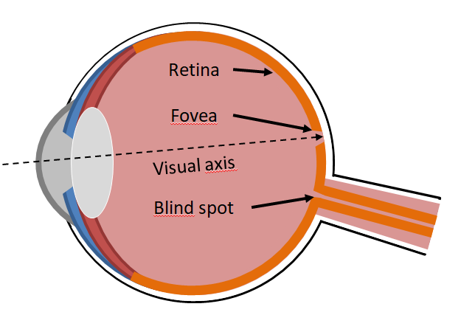
The human eye
180.000
Blind spot
160.000
140.000
cones
120.000
rods
100.000
80.000
60.000
40.000
20.000
0
90⁰
80⁰
70⁰
60⁰
50⁰
40⁰
30⁰
20⁰
10⁰
0⁰
10⁰
20⁰
30⁰
40⁰
50⁰
60⁰
70⁰
80⁰
90⁰
Fovea

Slide 7
Photographic camera

Slide 8
Photographic camera
Lens

Slide 9
Photographic camera
Diaphragm
Lens

Slide 10
Photographic camera
Diaphragm
Lens
Shutter

Slide 11
Photographic camera
Diaphragm
Lens
Sensor
Shutter

Slide 12
Photographic camera - lens

Slide 13
Photographic camera - lens
in focus

Slide 14
Photographic camera - lens
out of focus

Slide 15
Photographic camera - lens
out of focus

Slide 16
Photographic camera - diaphragm

Slide 17
Photographic camera - diaphragm

Slide 18
Photographic camera - diaphragm

Slide 19
Photographic camera - shutter

Slide 20
Photographic camera - shutter

Slide 21
Photographic camera - shutter

Slide 22
Photographic camera - shutter

Slide 23
Photographic camera - shutter

Slide 24
Photographic camera - shutter

Slide 25
Photographic camera - shutter

Slide 26
Photographic camera - shutter

Slide 27
Photographic camera - shutter

Slide 28
Photographic camera - shutter

Slide 29

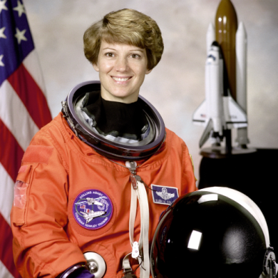
The digital image
Intensity image (gray levels):
Colored image (RGB):

Slide 30
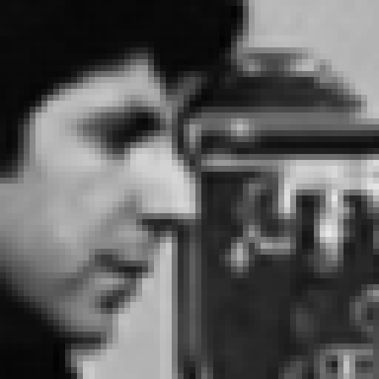
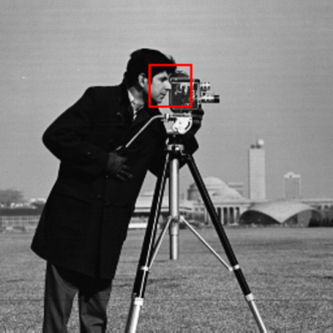
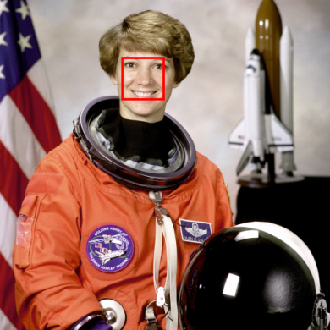

The digital image
Intensity image (gray levels):
Colored image (RGB):

Slide 31
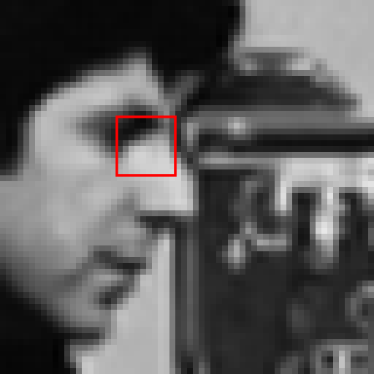

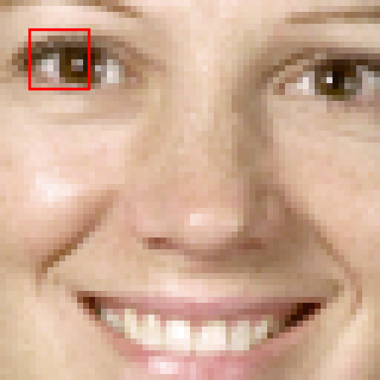

The digital image
Intensity image (gray levels):
Colored image (RGB):

Slide 32
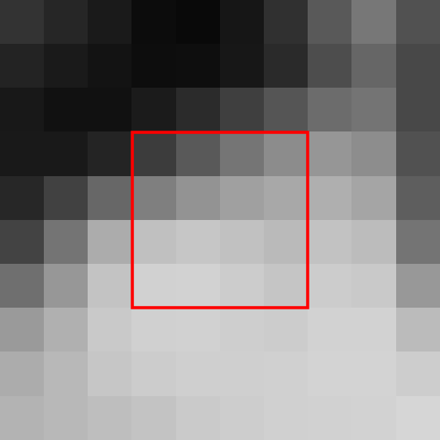

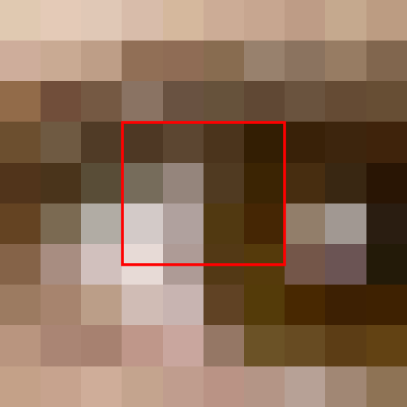

The digital image
Intensity image (gray levels):
Colored image (RGB):

Slide 33
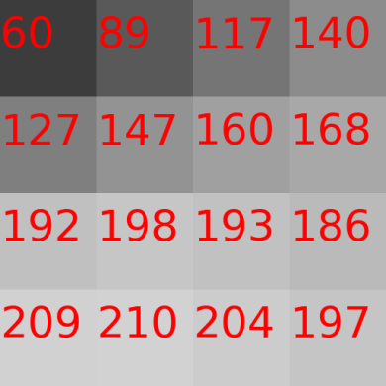
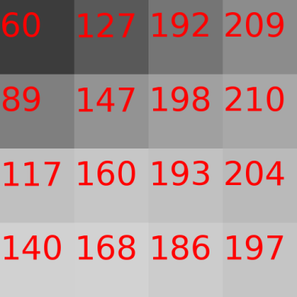
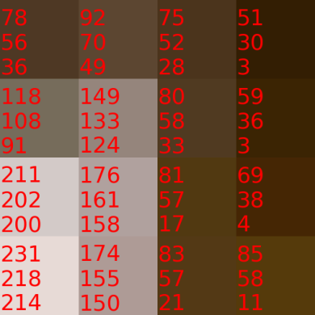
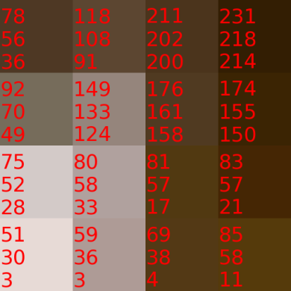
The digital image
Intensity image (gray levels):
Colored image (RGB):

Slide 34

The digital image
column y
 | 0 |  |  |  |  |  |  |  |  |  |  |  |  |  | N-1 |  | y
0
M-1
x
row x
f(x, y) = [R, G, B]
M rows
N columns
M × N pixels

Slide 35
Colored images - RGB

Slide 36
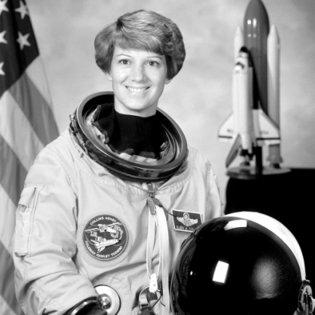
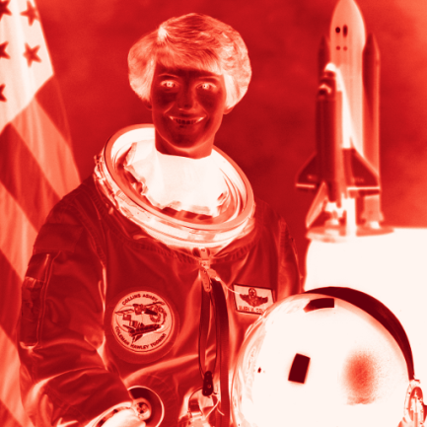
Colored images - RGB
R (red)

Slide 37
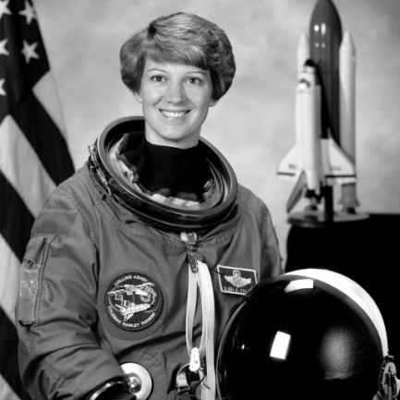
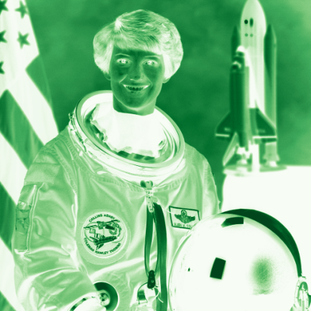
Colored images - RGB
R (red)
G (green)

Slide 38
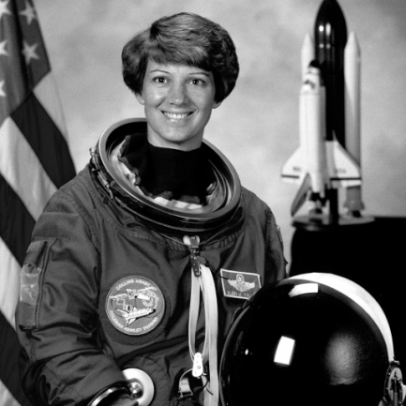
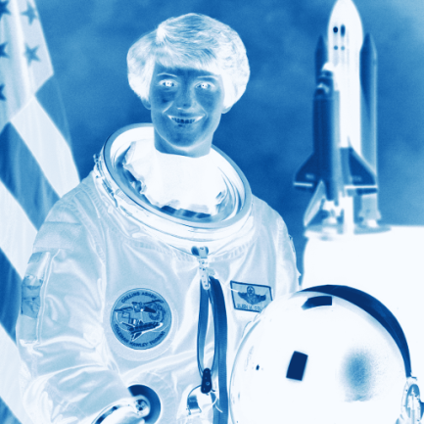
Colored images - RGB
R (red)
G (green)
B (blue)

Slide 39



Colored images - RGB
R (red)
G (green)
B (blue)

Slide 40
The RGB color space
B
Blue (0, 0, 255)
Cyan (0, 255, 255)
255
Magenta (255, 0, 255)
White (255, 255, 255)
Gray (127, 127, 127)
Green (0, 255, 0,)
0
Black (0, 0, 0)
255
G
255
R
Red (255, 0, 0)
Yellow (255, 255, 0)

Slide 41
Image acquisition

Slide 42
Image acquisition

Slide 43
Image acquisition

Slide 44
Image acquisition

Slide 45
Image acquisition

Slide 46
Image acquisition

Slide 47
Image acquisition

Slide 48
Image acquisition

Slide 49
Image acquisition
f(x, y) = i(x, y) × r(x, y)
I
i(x, y) | (in lux ou lumen/m²)
900 | Sunny day
100 | Cloud day
10 | Office
0.001 | Clear night
R
r(x, y)
0.93 | Snow
0.80 | White wall
0.65 | Stainless steel
0.01 | Black velvet
I : luminance
0 < i(x,y) < ∞
R : reflectance
0 < r(x,y) < 1
MARQUES FILHO, O.; VIEIRA NETO, H. Processamento digital de imagens. Brasport, 1999.

Slide 50
Image acquisition

Slide 51
Image acquisition

Slide 52
Image acquisition
Amplifier

Slide 53
Image acquisition
A/D converter
Amplifier

Slide 54
Image acquisition
A/D converter
Amplifier

Slide 55
CCD sensors and Bayer pattern
 | 0 | 1 | 2 | 3 | 4 | 5 | 6 | 7
0
1
2
3
4
5
6
7

Slide 56
CCD sensors and Bayer pattern
 | 0 | 1 | 2 | 3 | 4 | 5 | 6 | 7
0
1
2
3
4
5
6
7
 | 0 | 1 | 2 | 3 | 4 | 5 | 6 | 7
0
1
2
3
4
5
6
7
 | 0 | 1 | 2 | 3 | 4 | 5 | 6 | 7
0
1
2
3
4
5
6
7
 | 0 | 1 | 2 | 3 | 4 | 5 | 6 | 7
0
1
2
3
4
5
6
7

Slide 57
CCD sensors and Bayer pattern
 | 0 | 1 | 2 | 3 | 4 | 5 | 6 | 7
0
1
2
3
4
5
6
7
 | 0 | 1 | 2 | 3 | 4 | 5 | 6 | 7
0
1
2
3
4
5
6
7
 | 0 | 1 | 2 | 3 | 4 | 5 | 6 | 7
0
1
2
3
4
5
6
7
 | 0 | 1 | 2 | 3 | 4 | 5 | 6 | 7
0
1
2
3
4
5
6
7

Slide 58
CCD sensors and Bayer pattern
 | 0 | 1 | 2 | 3 | 4 | 5 | 6 | 7
0
1
2
3
4
5
6
7
 | 0 | 1 | 2 | 3 | 4 | 5 | 6 | 7
0
1
2
3
4
5
6
7
 | 0 | 1 | 2 | 3 | 4 | 5 | 6 | 7
0
1
2
3
4
5
6
7
 | 0 | 1 | 2 | 3 | 4 | 5 | 6 | 7
0
1
2
3
4
5
6
7

Slide 59
CCD sensors and Bayer pattern
 | 0 | 1 | 2 | 3 | 4 | 5 | 6 | 7
0
1
2
3
4
5
6
7
 | 0 | 1 | 2 | 3 | 4 | 5 | 6 | 7
0
1
2
3
4
5
6
7
 | 0 | 1 | 2 | 3 | 4 | 5 | 6 | 7
0
1
2
3
4
5
6
7
 | 0 | 1 | 2 | 3 | 4 | 5 | 6 | 7
0
1
2
3
4
5
6
7
 | 0 | 1 | 2 | 3 | 4 | 5 | 6 | 7
0
1
2
3
4
5
6
7

Slide 60
CCD sensors and Bayer pattern
 | 0 | 1 | 2 | 3 | 4 | 5 | 6 | 7
0
1
2
3
4
5
6
7
 | 0 | 1 | 2 | 3 | 4 | 5 | 6 | 7
0
1
2
3
4
5
6
7
 | 0 | 1 | 2 | 3 | 4 | 5 | 6 | 7
0
1
2
3
4
5
6
7
 | 0 | 1 | 2 | 3 | 4 | 5 | 6 | 7
0
1
2
3
4
5
6
7

Slide 61
CCD sensors and Bayer pattern
 | 0 | 1 | 2 | 3 | 4 | 5 | 6 | 7
0
1
2
3
4
5
6
7
 | 0 | 1 | 2 | 3 | 4 | 5 | 6 | 7
0
1
2
3
4
5
6
7
 | 0 | 1 | 2 | 3 | 4 | 5 | 6 | 7
0
1
2
3
4
5
6
7
 | 0 | 1 | 2 | 3 | 4 | 5 | 6 | 7
0
1
2
3
4
5
6
7

Slide 62
CCD sensors and Bayer pattern
 | 0 | 1 | 2 | 3 | 4 | 5 | 6 | 7
0
1
2
3
4
5
6
7
 | 0 | 1 | 2 | 3 | 4 | 5 | 6 | 7
0
1
2
3
4
5
6
7
 | 0 | 1 | 2 | 3 | 4 | 5 | 6 | 7
0
1
2
3
4
5
6
7
 | 0 | 1 | 2 | 3 | 4 | 5 | 6 | 7
0
1
2
3
4
5
6
7

Slide 63
CCD sensors and Bayer pattern
 | 0 | 1 | 2 | 3 | 4 | 5 | 6 | 7
0
1
2
3
4
5
6
7
 | 0 | 1 | 2 | 3 | 4 | 5 | 6 | 7
0
1
2
3
4
5
6
7
 | 0 | 1 | 2 | 3 | 4 | 5 | 6 | 7
0
1
2
3
4
5
6
7
 | 0 | 1 | 2 | 3 | 4 | 5 | 6 | 7
0
1
2
3
4
5
6
7
 | 0 | 1 | 2 | 3 | 4 | 5 | 6 | 7
0
1
2
3
4
5
6
7
 | 0 | 1 | 2 | 3 | 4 | 5 | 6 | 7
0
1
2
3
4
5
6
7
 | 0 | 1 | 2 | 3 | 4 | 5 | 6 | 7
0
1
2
3
4
5
6
7

Slide 64


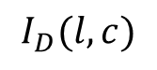
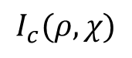
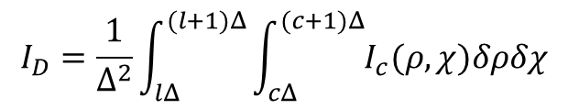
Sampling
lΔ
Δ
l
(l+1)Δ
$$I_{c}(ρ,χ)$$
cΔ
Δ
(c+1)Δ
$$I_{D}(l,c)$$
c
$$I_{D}=\frac{1}{Δ^{2}}\int_{lΔ}^{(l+1)Δ}{\int_{cΔ}^{(c+1)Δ}{I_{c}(ρ,χ)δρδχ}}$$
Based on: Alan Peters, 2019.

Slide 65

Sampling
Continuous RGB image

Slide 66
Sampling
Continuous RGB image

Slide 67
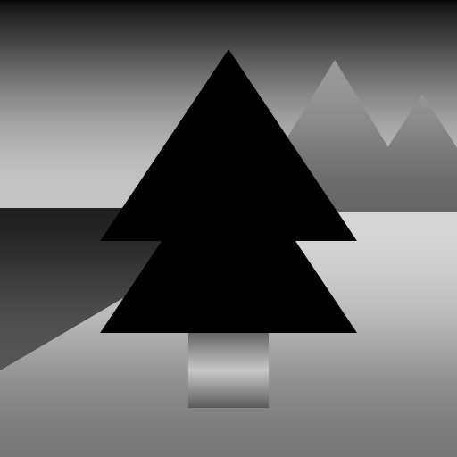


Sampling
Continuous RGB image
Continuous R image
Continuous G image
Continuous B image

Slide 68
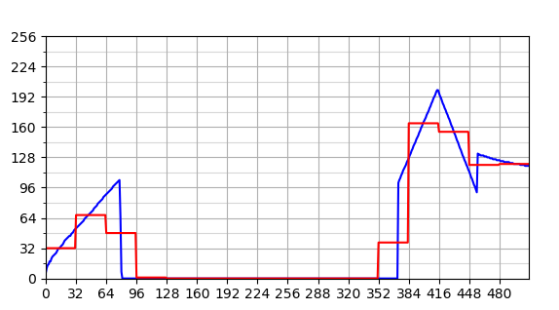
Sampling
Continuous RGB image
Continuous R image
Continuous G image
Continuous B image
R channel sampling

Slide 69
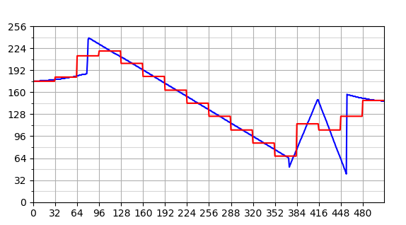
Sampling
Continuous RGB image
Continuous R image
Continuous G image
Continuous B image
R channel sampling
G channel sampling

Slide 70
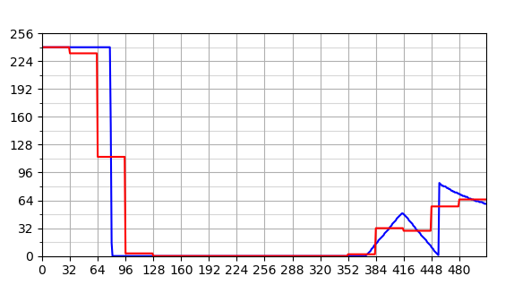
Sampling
Continuous RGB image
Continuous R image
Continuous G image
Continuous B image
R channel sampling
G channel sampling
B channel sampling

Slide 71
Sampling
Continuous RGB image
Continuous R image
Continuous G image
Continuous B image
Discrete RGB image (sampled)
R channel sampling
G channel sampling
B channel sampling

Slide 72

Sampling
Continuous gray level image

Slide 73
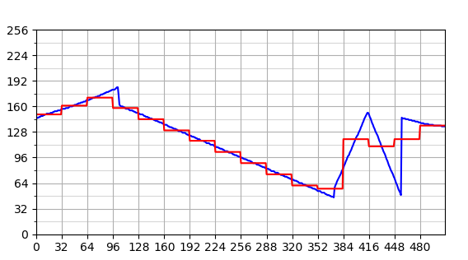
Sampling
Continuous gray level image
Gray level image sampling

Slide 74
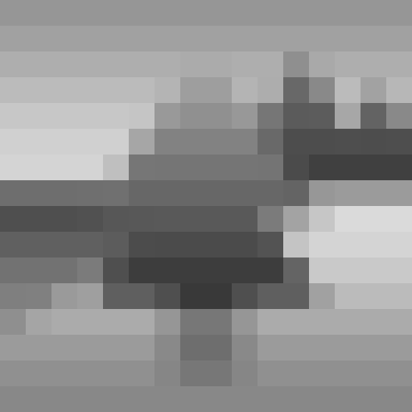
Sampling
Continuous gray level image
Gray level image sampling
Discrete gray level image (sampled)

Slide 75




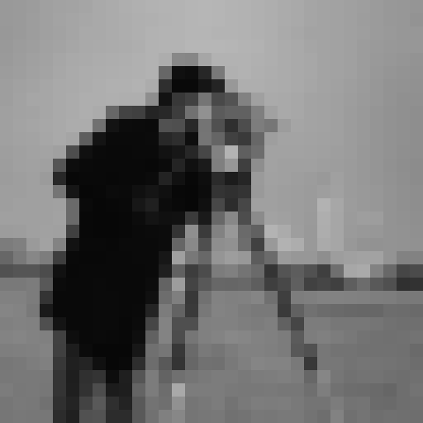
Effects of spatial resolution
1,7 pol
300 ppi – 512 x 512
1,7 pol. a 150 ppi – 256 x 256
1,7 pol. a 75 ppi – 128 x 128
1,7 pol. a ~38 ppi – 64 x 64
1,7 pol. a 19 ppi – 32 x 32

Slide 76





Effects of spatial resolution
0,85 pol.
256 x 256 pixels
300 ppi
1,7 pol.
512 x 512 pixels
300 ppi
0,43 pol.
128 x 128 pixels
300 ppi
0,21 pol.
64 x 64 pixels
300 ppi
0,11 pol.
32 x 32 pixels
300 ppi

Slide 77
Intensity resolution
∞ gray levels
8 bits
256 gray levels
7 bits
128 gray levels
6 bits
64 gray levels
5 bits
32 gray levels
4 bits
16 gray levels
3 bits
8 gray levels
2 bits
4 gray levels
1 bit
2 gray levels

Slide 78
Intensity resolution
∞ gray levels
8 bits
256 gray levels
7 bits
128 gray levels
6 bits
64 gray levels
5 bits
32 gray levels
4 bits
16 gray levels
3 bits
8 gray levels
2 bits
4 gray levels
1 bit
2 gray levels

Slide 79




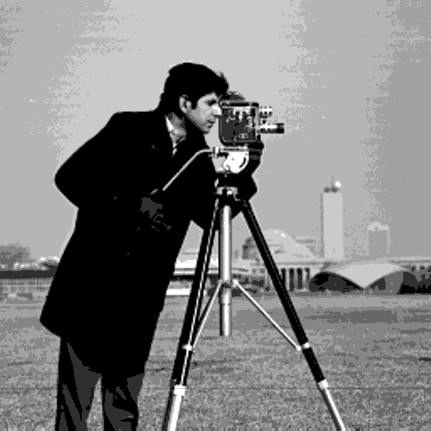
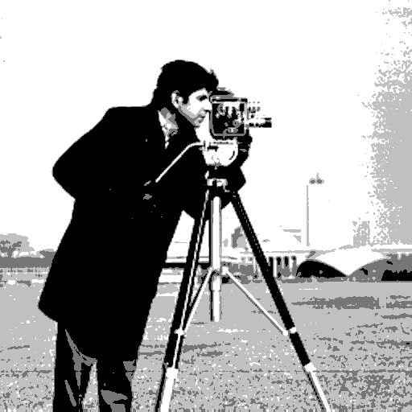
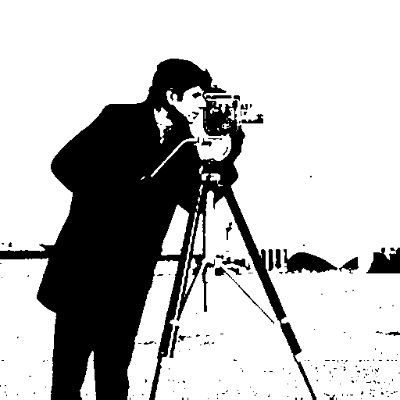
Effects of intensity resolution
8 bits. 2⁸ = 256 gray levels
7 bits. 2⁷ = 128 gray levels
6 bits. 2⁶ = 64 gray levels
5 bits. 2⁵ = 32 gray levels
4 bits. 2⁴ = 16 gray levels
3 bits. 2³ = 8 gray levels
2 bits. 2² = 4 gray levels
1 bit. 2¹ = 2 gray levels

Slide 80
Bibliography
GONZALEZ, R.C.; WOODS, R.E. Digital Image Processing. 3rd ed. Pearson, 2007.
Sections 2.1, 2.2, 2.3 e 2.4
MARQUES FILHO, O.; VIEIRA NETO, H. Processamento digital de imagens. Brasport, 1999.
(in Brazilian Portuguese)
Available on the author's website (for personal use only)
http://dainf.ct.utfpr.edu.br/~hvieir/pub.html
Section 2.1
J. E. R. Queiroz, H. M. Gomes. Introdução ao Processamento Digital de Imagens. RITA. v. 13, 2006.
(in Brazilian Portuguese)
http://www.dsc.ufcg.edu.br/~hmg/disciplinas/graduacao/vc-2016.2/Rita-Tutorial-PDI.pdf
Section 2
PETERS, A. Lectures on Image Processing. Vanderbilt University, 2019.
https://archive.org/details/Lectures_on_Image_Processing

Slide 81
Complementary bibliography
Felipe Arruda. Vídeo explica como funciona o sensor CCD das câmeras digitais. Tecmundo, 2012.
(in Brazilian Portuguese)
https://www.tecmundo.com.br/fotografia-e-design/23626-video-explica-como-funciona-o-sensor-ccd-das-cameras-digitais.htm
Bill Hammack. CCD: The heart of a digital camera (how a charge-coupled device works). YouTube. Canal: engineerguy.
https://www.youtube.com/watch?v=wsdmt0De8Hw&feature=youtu.be
Raymond Siri. CMOS Animation Sequence. Vimeo
https://vimeo.com/103279734
Raymond Siri. CCD Animation Sequence. Vimeo
https://vimeo.com/103279733

Slide 82
Complementary bibliography
Rafael Helerbrock. Quais são os limites da visão humana? Mundo Educação
(in Brazilian Portuguese)
https://mundoeducacao.uol.com.br/fisica/quais-sao-os-limites-visao-humana.htm
Francie Diep. Humans Can Only Distinguish Between About 30 Shades Of Gray. Popular Science, 2015.
(in Brazilian Portuguese)
https://www.popsci.com/humans-can-only-distinguish-between-about-30-shades-gray/
Luciana Galastri. Humanos conseguem distinguir apenas 30 tons de cinza. Galileu, 2015.
(in Brazilian Portuguese)
https://revistagalileu.globo.com/Ciencia/noticia/2015/02/humanos-conseguem-distinguir-apenas-30-tons-de-cinza.html

Slide 83
THE END
@misc{mari_im_proc_2023,
author = {João Fernando Mari},
title = {Fundamentals of digital imaging I},
year = {2023},
publisher = {GitHub},
journal = {Introduction to digital image processing - UFV},
howpublished = {\url{https://github.com/joaofmari/SIN392_Introduction-to-digital-image-processing_2023}}
}

